Slide 1
Data Structure Lower Bounds in the Cell Probe Model
Kasper Green Larsen
Aarhus University
Notes:
Will focus on 3d!

Slide 2
Overview Lecture
Less proofs.
Overview of significant directions beyond ”highest lower bounds”
Concrete problems where we have lower bounds.
Open problems.
Notes:
Overlay poly, telefon

Slide 3
Time Line Dynamic Lower Bounds
Highest dynamic cell probe lower bounds.
  Assume n^{c} queries for c=O(1) and w=Θ(lgn).
  1989: Fredman and Saks
      max{t_{q},t_{u}} = Ω(lgn/lglgn).
  2004: Patrascu and Demaine
      max{t_{q},t_{u}} = Ω(lgn).
  2012: Larsen
        max{t_{q},t_{u}} = Ω((lgn/lglgn)²).
Notes:
Overlay poly, telefon

Slide 4
Time Line Dynamic Lower Bounds
Highest dynamic cell probe lower bounds.
  Assume n^{c} queries for c=O(1), output 1 bit and w=Θ(lgn).
  1989: Fredman and Saks
      max{t_{q},t_{u}} = Ω(lgn/lglgn).
  2004: Patrascu and Demaine
      max{t_{q},t_{u}} = Ω(lgn).
  2018: Larsen, Weinstein and Yu
      max{t_{q},t_{u}} = Ω((lgn)^{1.5}/(lglgn)²).
Notes:
Overlay poly, telefon

Slide 5
Decision Problems Examples
Dynamic Connectivity
  Input: Empty graph on n nodes.
  Update(u,v): Add edge u to v.
  Query(u,v): Is there a path from u to v?
C
F
E
B
A
D
Notes:
Overlay poly, telefon

Slide 6
Decision Problems Examples
Dynamic Range Parity:
  Input: Empty [n]x[n] grid.
  Update(x,y): Insert point at (x,y).
  Query(x,y): Return parity of #point dominated by (x,y)
Even #points, so answer is 0.
Notes:
Overlay poly, telefon

Slide 7
Decision Problems Examples
Dynamic Range Counting:
  Input: Empty [n]x[n] grid.
  Update(x,y): Insert point at (x,y).
  Query(x,y): Return #point dominated by (x,y)
Answer is 2
Notes:
Overlay poly, telefon

Slide 8
Decision Problems Examples
Dynamic Parity Range Median:
  Input: Array A of length n. Initally all entries 0.
  Update(i,y): Change A[i] to y in {0,…,n-1}
  Query(i,j): Return whether median (A[i],A[i+1],…,A[j]) is stored in even or odd position.
  Median(0,0,1,2,3)=1.
  Median stored at position 2.
  Answer is 0 (even position).
0 | 1 | 2 | 3 | 4 | 5 | 6 | 7 | 8 | 9
0
0
0
3
0 | 0 |  | 0 |  |  | 0 | 0 | 0 | 0
1
2
Notes:
Overlay poly, telefon

Slide 9
Decision Problems Examples
Dynamic Range Median:
  Input: Array A of length n. Initally all entries 0.
  Update(i,y): Change A[i] to y in {0,…,n-1}
  Query(i,j): Return position of median (A[i],A[i+1],…,A[j]).
  Median(0,0,1,2,3)=1.
  Median stored at position 2.
  Answer is 2.
0 | 1 | 2 | 3 | 4 | 5 | 6 | 7 | 8 | 9
1
2
3
0 | 0 |  | 0 |  |  | 0 | 0 | 0 | 0
Notes:
Overlay poly, telefon

Slide 10
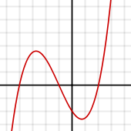
Decision Problems Examples
Dynamic Parity Polynomial Evaluation:
  Input: Degree n-1 polynomial over 𝔽_{p} for p=θ(n²):
    P(x)=a_{n-1}x^{n-1}+…+a₁x+a₀
    Initially a_{i}=0 for all i.
  Query(x): Element x in 𝔽_{p}, return parity of P(x).
  Update(i,y): Change a_{i} to y.
Example p=7, n=3:
  P(x) = 3x²+x+5.
  Query x=4, has answer:
    P(4) = ((3*16+4+5) mod 7) mod 2 = 1.
Notes:
Overlay poly, telefon

Slide 11
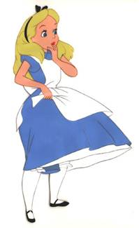

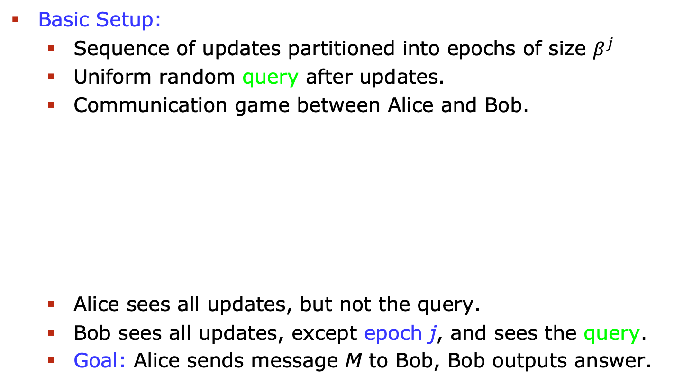
L, Weinstein & Yu’s Technique
Basic Setup:
  Sequence of updates partitioned into epochs of size $β^{j}$
  Uniform random query after updates.
  Communication game between Alice and Bob.
  Alice sees all updates, but not the query.
  Bob sees all updates, except epoch j, and sees the query.
  Goal: Alice sends message M to Bob, Bob outputs answer.
Message M
Notes:
Overlay poly, telefon

Slide 12

L, Weinstein & Yu’s Technique
Main Result:
  From data structure with query time t_{q}, update time t_{u} and cell size w, can get protocol:
Protocol: $\left|M\right|=O(β^{j}/{\left(wt_{u}\right)}^{10}$). Bob answers correctly with probability at least $\frac{1}{2}+e^{−O(t_{q} {(\lg{(w t_{u}))}}^{2}/\sqrt{\lg{n})}}$.
Message M
Slightly better than guessing.
Less than full epoch.
Notes:
Overlay poly, telefon

Slide 13
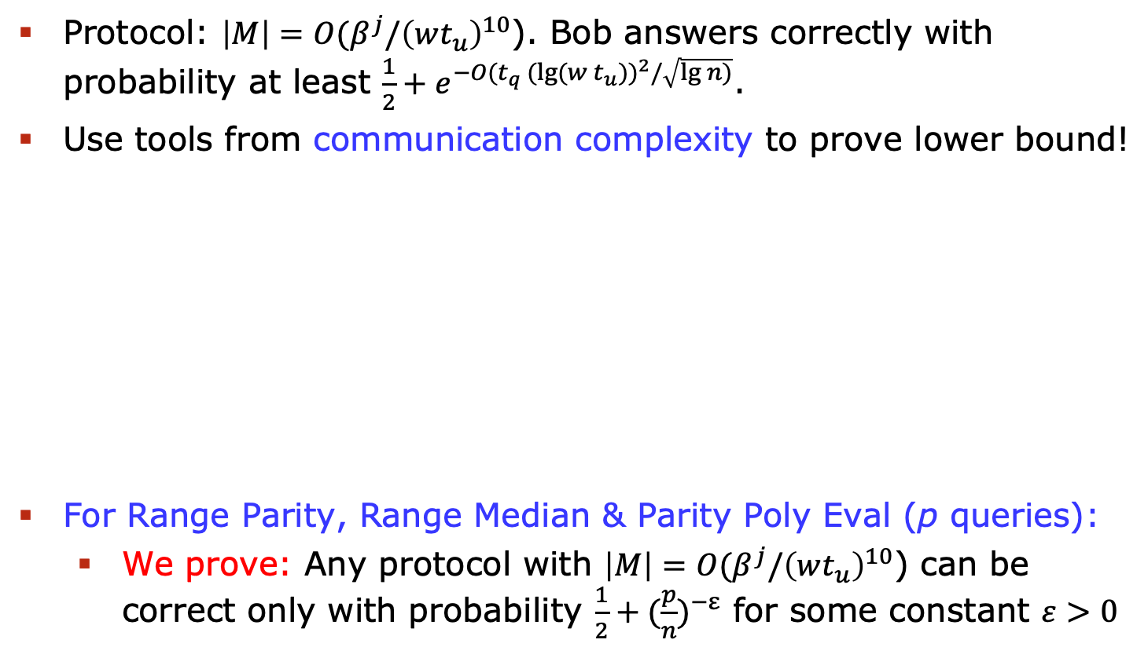
L, Weinstein & Yu’s Technique
Protocol: $\left|M\right|=O(β^{j}/{\left(wt_{u}\right)}^{10}$). Bob answers correctly with probability at least $\frac{1}{2}+e^{−{O(t}_{q} {(\lg{(w t_{u}))}}^{2}/\sqrt{\lg{n})}}$.
Use tools from communication complexity to prove lower bound!
For Range Parity, Range Median & Parity Poly Eval (p queries):
  We prove: Any protocol with $\left|M\right|=O(β^{j}/{\left(wt_{u}\right)}^{10}$) can be correct only with probability $\frac{1}{2}+{(\frac{p}{n})}^{−ε}$ for some constant $ε>0$
Message M
Notes:
Overlay poly, telefon

Slide 14
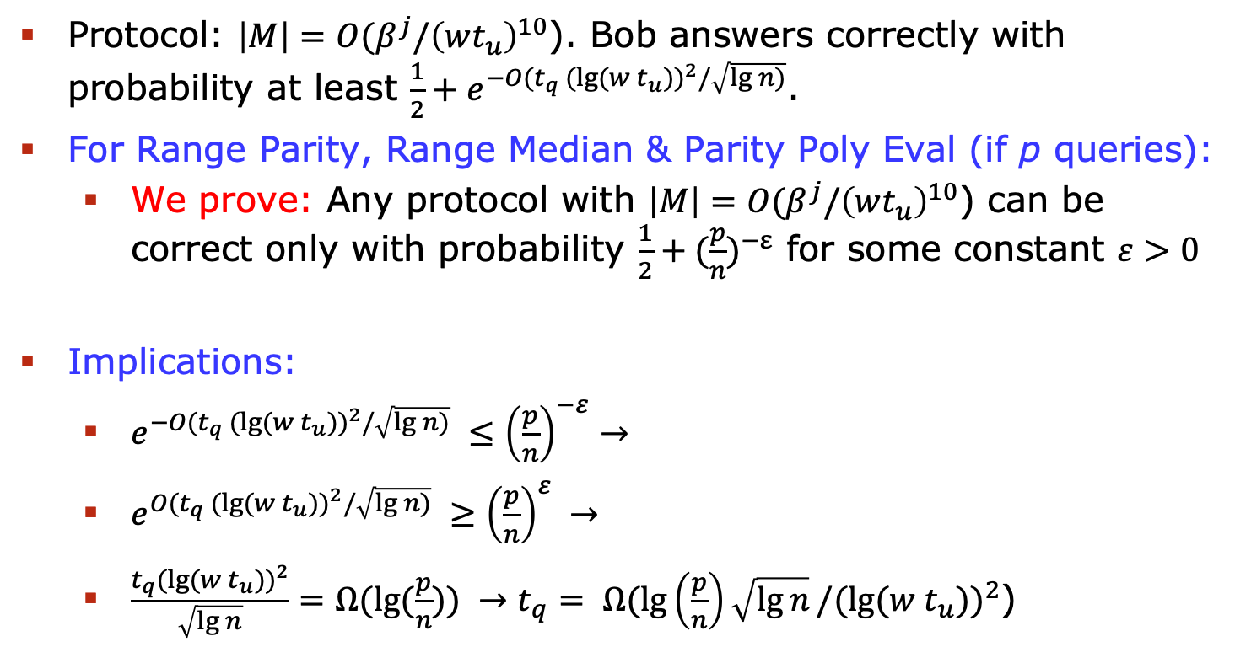
L, Weinstein & Yu’s Technique
Protocol: $\left|M\right|=O(β^{j}/{\left(wt_{u}\right)}^{10}$). Bob answers correctly with probability at least $\frac{1}{2}+e^{−{O(t}_{q} {(\lg{(w t_{u}))}}^{2}/\sqrt{\lg{n})}}$.
For Range Parity, Range Median & Parity Poly Eval (if p queries):
  We prove: Any protocol with $\left|M\right|=O(β^{j}/{\left(wt_{u}\right)}^{10}$) can be correct only with probability $\frac{1}{2}+{(\frac{p}{n})}^{−ε}$ for some constant $ε>0$
Implications:
  $e^{−{O(t}_{q} {(\lg{(w t_{u}))}}^{2}/\sqrt{\lg{n})}} ≤{\left(\frac{p}{n}\right)}^{−ε}→$
  $e^{{O(t}_{q} {(\lg{(w t_{u}))}}^{2}/\sqrt{\lg{n})}} ≥{\left(\frac{p}{n}\right)}^{ε} →$
  $\frac{t_{q}{(\lg{(w t_{u}))}}^{2}}{\sqrt{\lg{n}}}=Ω(\lg{(\frac{p}{n}))} →t_{q}= Ω(\lg\left(\frac{p}{n}\right)\sqrt{\lg{n}}/{(\lg{(w t_{u}))}}^{2}$)
Notes:
Overlay poly, telefon

Slide 15
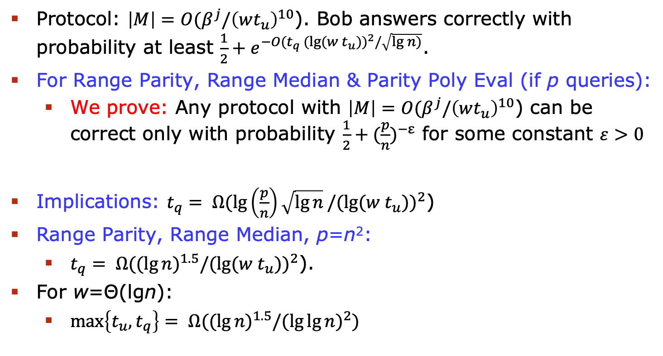
L, Weinstein & Yu’s Technique
Protocol: $\left|M\right|=O(β^{j}/{\left(wt_{u}\right)}^{10}$). Bob answers correctly with probability at least $\frac{1}{2}+e^{−{O(t}_{q} {(\lg{(w t_{u}))}}^{2}/\sqrt{\lg{n})}}$.
For Range Parity, Range Median & Parity Poly Eval (if p queries):
  We prove: Any protocol with $\left|M\right|=O(β^{j}/{\left(wt_{u}\right)}^{10}$) can be correct only with probability $\frac{1}{2}+{(\frac{p}{n})}^{−ε}$ for some constant $ε>0$
Implications: $t_{q}= Ω(\lg\left(\frac{p}{n}\right)\sqrt{\lg{n}}/{(\lg{(w t_{u}))}}^{2}$)
Range Parity, Range Median, p=n²:
  $t_{q}= Ω({(\lg{n)}}^{1.5}/{(\lg{(w t_{u}))}}^{2}$).
For w=Θ(lgn):
  $\max\left\{t_{u},t_{q}\right\}= Ω({(\lg{n)}}^{1.5}/(\lg{{\lg{n)}}^{2}})$
Notes:
Overlay poly, telefon

Slide 16
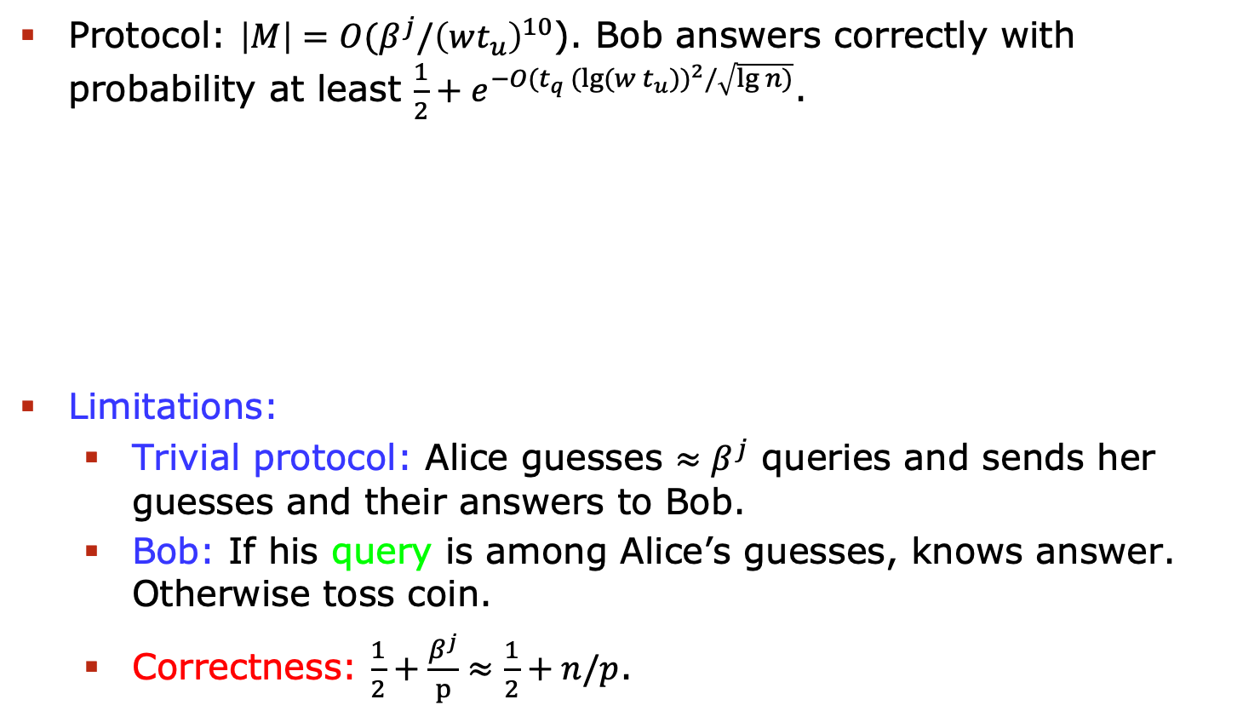
L, Weinstein & Yu’s Technique
Protocol: $\left|M\right|=O(β^{j}/{\left(wt_{u}\right)}^{10}$). Bob answers correctly with probability at least $\frac{1}{2}+e^{−{O(t}_{q} {(\lg{(w t_{u}))}}^{2}/\sqrt{\lg{n})}}$.
Limitations:
  Trivial protocol: Alice guesses $≈β^{j}$ queries and sends her guesses and their answers to Bob.
  Bob: If his query is among Alice’s guesses, knows answer. Otherwise toss coin.
  Correctness: $\frac{1}{2}+\frac{β^{j}}{p}≈\frac{1}{2}+n/p$.
Message M
Up to constants, we got max possible lower bound!
Notes:
Overlay poly, telefon

Slide 17
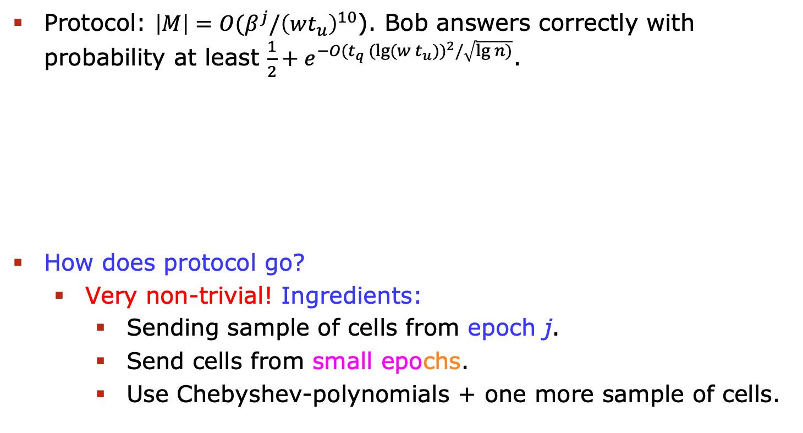
L, Weinstein & Yu’s Technique
Protocol: $\left|M\right|=O(β^{j}/{\left(wt_{u}\right)}^{10}$). Bob answers correctly with probability at least $\frac{1}{2}+e^{−{O(t}_{q} {(\lg{(w t_{u}))}}^{2}/\sqrt{\lg{n})}}$.
How does protocol go?
  Very non-trivial! Ingredients:
    Sending sample of cells from epoch j.
    Send cells from small epochs.
    Use Chebyshev-polynomials + one more sample of cells.
Message M
Notes:
Overlay poly, telefon

Slide 18
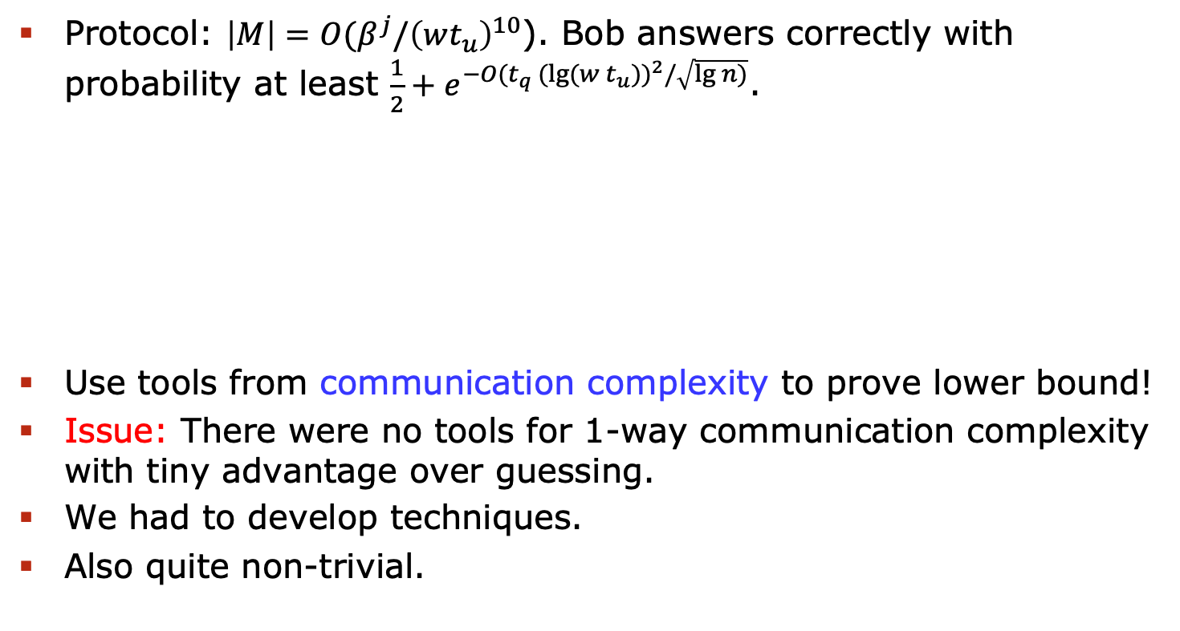
L, Weinstein & Yu’s Technique
Protocol: $\left|M\right|=O(β^{j}/{\left(wt_{u}\right)}^{10}$). Bob answers correctly with probability at least $\frac{1}{2}+e^{−{O(t}_{q} {(\lg{(w t_{u}))}}^{2}/\sqrt{\lg{n})}}$.
Use tools from communication complexity to prove lower bound!
Issue: There were no tools for 1-way communication complexity with tiny advantage over guessing.
We had to develop techniques.
Also quite non-trivial.
Message M
Notes:
Overlay poly, telefon

Slide 19
Time Line Dynamic Lower Bounds
Highest dynamic cell probe lower bounds.
  Assume n^{c} queries for c=O(1), output 1 bit and w=Θ(lgn).
  1989: Fredman and Saks
      max{t_{q},t_{u}} = Ω(lgn/lglgn).
  2004: Patrascu and Demaine
      max{t_{q},t_{u}} = Ω(lgn).
  2018: Larsen, Weinstein and Yu
      max{t_{q},t_{u}} = Ω((lgn)^{1.5}/(lglgn)²).
Main Open Problem: Prove
  max{t_{q},t_{u}} = Ω((lgn/lglgn)²).
Seems within reach
Notes:
Overlay poly, telefon

Slide 20
Non-Adaptive Data Structures
Polynomial Lower Bounds:
  We can prove them for non-adaptive dynamic data structures!
Non-Adaptive:
  Set of cells probed on query x determined from x alone!
a_{v}
a₁,a₂,…,a_{t}
00
01
10
11
10,11,…,10
a_{i}
a_{j}
a_{k}
a_{l}
2km
8km
_{8km}
Adaptive
Non-Adaptive
Notes:
Overlay poly, telefon

Slide 21
Non-Adaptive Data Structures
Polynomial Lower Bounds:
  We can prove them for non-adaptive dynamic data structures!
Brody, Larsen’15:
  Updates may be adaptive!
  Problem: Indexing.
Output j’th bit of S_{i}
S₀,…,S_{k-1} in {0,1}^{n}
Index j in [n]
Query i in [k]
0
1
1
0
1
1
1
1
1
1
0
1
0
1
0
1
0
1
…
4
1
Preprocessing
Update
Query
Notes:
Overlay poly, telefon

Slide 22
Non-Adaptive Data Structures
S₀,…,S_{k-1} in {0,1}^{n}
Index j in [n]
Query i in [k]
Interesting via Reductions:
  Dynamic Connectivity in Directed Graphs:
0
1
1
0
1
1
1
1
1
1
0
1
0
1
0
1
0
1
…
4
1
Output j’th bit of S_{i}
Preprocessing
Update
Query
Query: Can S_{i} reach t?
Preprocessing: Add edge from S_{i} to j if j’th bit of S_{i} is 1.
S₀
S₁
…
S_{k-1}
0
1
2
3
4
5
Update: Add edge from j to t.
t
Notes:
Overlay poly, telefon

Slide 23
Non-Adaptive Data Structures
S₀,…,S_{k-1} in {0,1}^{n}
Index j in [n]
Query i in [k]
Interesting via Reductions:
  Dynamic Connectivity in Directed Graphs:
    Non-Adaptive Dynamic Connectivity Data Structure with preprocessing time t_{p}, update time t_{u}, query time t_{q}, cell size w, gives solution with same parameters for Indexing.
0
1
1
0
1
1
1
1
1
1
0
1
0
1
0
1
0
1
…
4
1
Output j’th bit of S_{i}
Preprocessing
Update
Query
Notes:
Overlay poly, telefon

Slide 24

Non-Adaptive Data Structures
S₀,…,S_{k-1} in {0,1}^{n}
Index j in [n]
Query i in [k]
Lower Bound for Non-Adaptive:
  Must have either $t_{q}=Ω(\frac{n}{w})$ or $t_{u}= Ω(\frac{k}{w})$, regardless of t_{p}!
  Same lower bound for Non-Adaptive Dynamic Connectivity.
0
1
1
0
1
1
1
1
1
1
0
1
0
1
0
1
0
1
…
4
1
Output j’th bit of S_{i}
Preprocessing
Update
Query
Notes:
Overlay poly, telefon

Slide 25

Non-Adaptive Data Structures
S₀,…,S_{k-1} in {0,1}^{n}
Index j in [n]
Query i in [k]
Lower Bound for Non-Adaptive:
  Must have either $t_{q}=Ω(\frac{n}{w})$ or $t_{u}= Ω(\frac{k}{w})$, regardless of t_{p}!
Tight:
  Update: just write down j in some fixed cell.
  Query: Read j from fixed cell and all of S_{i}. Output!
  t_{u}=O(1), t_{q}=O(n/w).
0
1
1
0
1
1
1
1
1
1
0
1
0
1
0
1
0
1
…
4
1
Output j’th bit of S_{i}
Preprocessing
Update
Query
Notes:
Overlay poly, telefon

Slide 26
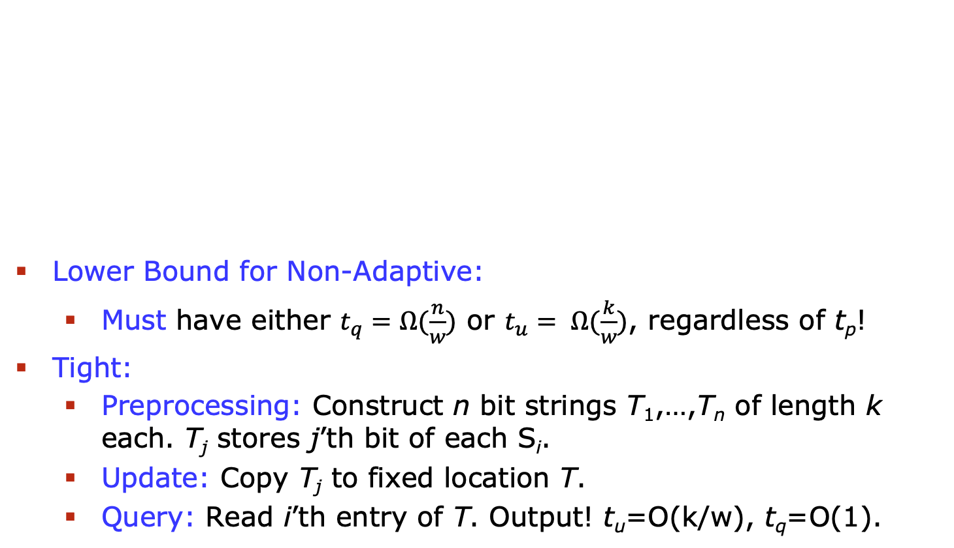
Non-Adaptive Data Structures
S₀,…,S_{k-1} in {0,1}^{n}
Index j in [n]
Query i in [k]
Lower Bound for Non-Adaptive:
  Must have either $t_{q}=Ω(\frac{n}{w})$ or $t_{u}= Ω(\frac{k}{w})$, regardless of t_{p}!
Tight:
  Preprocessing: Construct n bit strings T₁,…,T_{n} of length k each. T_{j} stores j’th bit of each S_{i}.
  Update: Copy T_{j} to fixed location T.
  Query: Read i’th entry of T. Output! t_{u}=O(k/w), t_{q}=O(1).
0
1
1
0
1
1
1
1
1
1
0
1
0
1
0
1
0
1
T₂
…
4
1
Output j’th bit of S_{i}
Preprocessing
Update
Query
Notes:
Overlay poly, telefon

Slide 27

Non-Adaptive Data Structures
S₀,…,S_{k-1} in {0,1}^{n}
Index j in [n]
Query i in [k]
Lower Bound for Non-Adaptive:
  Must have either $t_{q}=Ω(\frac{n}{w})$ or $t_{u}= Ω(\frac{k}{w})$, regardless of t_{p}!
Intuition for why hard:
  Output of query depends on the j that was updated.
  But you are not allowed to be adaptive to what is stored!
  Obvious in Indexing, perhaps less so in Dynamic Conn.
0
1
1
0
1
1
1
1
1
1
0
1
0
1
0
1
0
1
…
4
1
Output j’th bit of S_{i}
Preprocessing
Update
Query
Notes:
Overlay poly, telefon

Slide 28
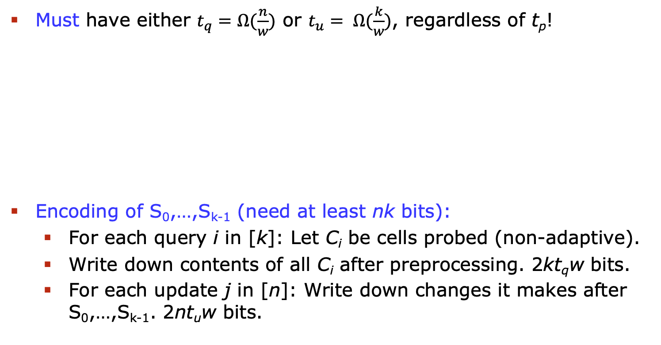
Proof
Must have either $t_{q}=Ω(\frac{n}{w})$ or $t_{u}= Ω(\frac{k}{w})$, regardless of t_{p}!
Encoding of S₀,…,S_{k-1} (need at least nk bits):
  For each query i in [k]: Let C_{i} be cells probed (non-adaptive).
  Write down contents of all C_{i} after preprocessing. 2kt_{q}w bits.
  For each update j in [n]: Write down changes it makes after S₀,…,S_{k-1}. 2nt_{u}w bits.
S₀,…,S_{k-1} in {0,1}^{n}
0
1
1
0
1
1
1
1
1
1
0
1
0
1
0
1
0
1
…
Encoding M
Notes:
Overlay poly, telefon

Slide 29
Proof
Encoding of S₀,…,S_{k-1} (need at least nk bits):
  For each query i in [k]: Let C_{i} be cells probed (non-adaptive).
  Write down contents of all C_{i} after preprocessing. 2kt_{q}w bits.
  For each update j in [n]: Write down changes it makes after S₀,…,S_{k-1}. 2nt_{u}w bits.
Decoding:
  Set cell contents of all C_{i} as received from encoder.
  For each update j in [n]: Apply the changes it makes (known).
    For each query i in [k]: Run query algorithm. Need only cells in C_{i} since non-adaptive.
  Learn j’th bit of S_{i} for every i and j!
Notes:
Overlay poly, telefon

Slide 30
Non-Adaptive Data Structures
Polynomial Lower Bounds:
  We can prove them for non-adaptive dynamic data structures!
Other works:
  Recently a number of papers on non-adaptive lower bounds.
  Not polynomial, but for interesting problems.
  Examples:
    Rao, Ramamoorthy’18: Lower bounds for maintaining dynamic set supporting median queries. Logarithmic.
    Boninger, Brody, Kephart’18: Lower bounds for predecessor search. Logarithmic.
    Persiano, Yeo’20: Lower bounds for non-adaptive static membership (hash tables). t ≥ lg(p/n)/lg(S/n) for universe [p].
Notes:
Overlay poly, telefon

Slide 31
Non-Adaptive Data Structures
Polynomial Lower Bounds:
  We can prove them for non-adaptive dynamic data structures!
Good Open Problems:
  Can we prove stronger than t ≥ lg(p/n)/lg(S/n) lower bounds for non-adaptive static data structures?
  Can we prove polynomial lower bounds for dynamic data structures if the update algorithm is non-adaptive instead of the query algorithm?
    We can for some even more restricted data structures, see Brody, Larsen’15.
Notes:
Overlay poly, telefon

Slide 32
Barriers
Matrix-Rigidity and Circuit Lower Bounds
  Exciting recent work by Dvir, Golovnev, Weinstein’19.
Setup: nxn matrix A over 𝔽_{p}.
  (r,d)-rigid if decreasing rank(A) below r requires ≥d edits.
Introduced by Valiant’77.
  Strong rigidity bounds for explicit matrix A gives super-linear lower bounds for linear circuits computing linear operator.
  Big open problem in circuit complexity.
Notes:
Overlay poly, telefon

Slide 33
Barriers
Dvir, Golovnev, Weinstein’19:
  Consider a static range searching data structure problem:
  Input: Set of points with weights 0/1.
  Goal: Preprocess such that parity inside query range can be found efficiently.
Notes:
Overlay poly, telefon

Slide 34
Barriers
Dvir, Golovnev, Weinstein’19:
  Consider a static range searching data structure problem:
Incidence matrix from problem:
  Row pr. query, column pr. point. A_{i,j}=1 iff j’th point is in i’th query.
0 | 0 | 1 | 1 | 0
Notes:
Overlay poly, telefon

Slide 35
Barriers
Dvir, Golovnev, Weinstein’19:
  Consider a static range searching data structure problem:
Incidence matrix from problem:
  Row pr. query, column pr. point. A_{i,j}=1 iff j’th point is in i’th query.
  Result: Data structure lower bound implies rigidity lower bounds for A.
Notes:
Overlay poly, telefon

Slide 36
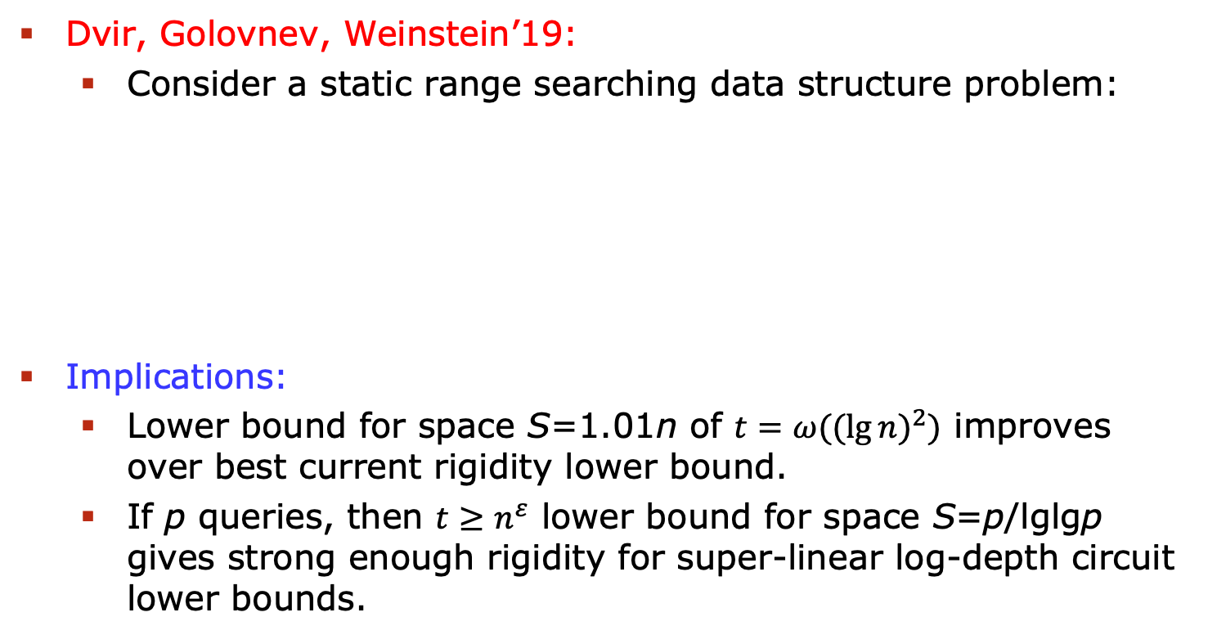
Barriers
Dvir, Golovnev, Weinstein’19:
  Consider a static range searching data structure problem:
Implications:
  Lower bound for space S=1.01n of $t=ω({(\lg{n)}}^{2})$ improves over best current rigidity lower bound.
  If p queries, then $t≥n^{ε}$ lower bound for space S=p/lglgp gives strong enough rigidity for super-linear log-depth circuit lower bounds.
Notes:
Overlay poly, telefon

Slide 37
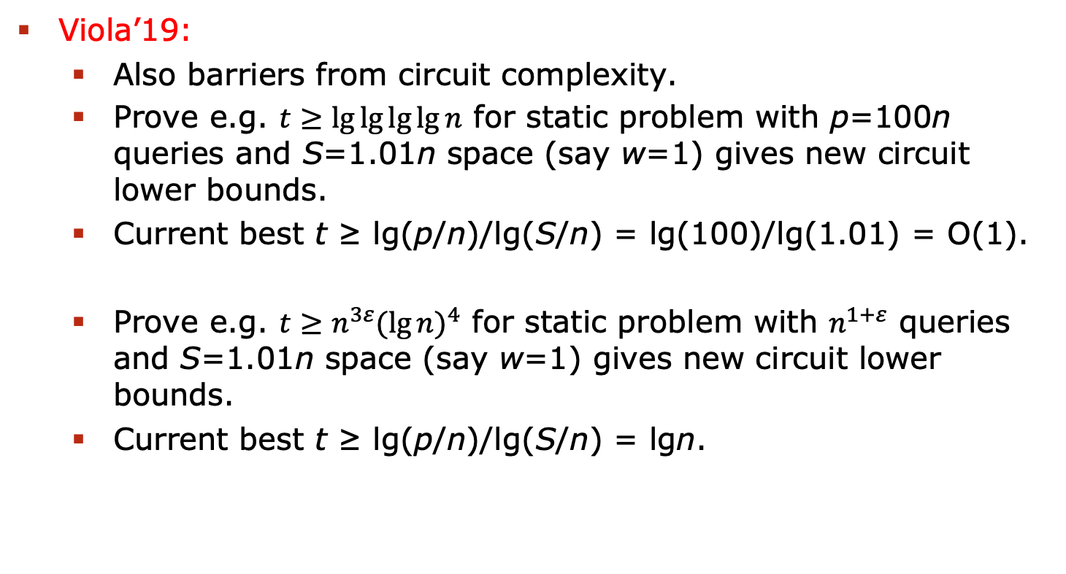
Barriers
Viola’19:
  Also barriers from circuit complexity.
  Prove e.g. $t≥\lg{\lg{\lg{\lg{n}}}}$ for static problem with p=100n queries and S=1.01n space (say w=1) gives new circuit lower bounds.
  Current best t ≥ lg(p/n)/lg(S/n) = lg(100)/lg(1.01) = O(1).
  Prove e.g. $t≥n^{3ε}{(\lg{n)}}^{4}$ for static problem with $n^{1+ε}$ queries and S=1.01n space (say w=1) gives new circuit lower bounds.
  Current best t ≥ lg(p/n)/lg(S/n) = lgn.
Notes:
Overlay poly, telefon

Slide 38
Barriers
Personally:
  I don’t need circuit implications to be impressed.
  We like circuit implications because many have looked at circuits.
  My opinion: Many have also looked at data structures since 1989 (arguably somewhat less).
  In the early days, many famous complexity theorists:
    Kushilevitz, Wigderson, Nisan, Ajtai, Yao, Beame, Rabani, Ostrovsky,…
    Recently: Thorup, Patrascu, Rao, Viola, Pitassi, Koucky, Chattopadhya, Weinstein, Yu…
    (Non-exhaustive, no insult intended if someone you know worked on DS lower bounds and is not on the list).
My advice: Don’t take ”proofs by intimidation” too seriously.
Notes:
Overlay poly, telefon

Slide 39
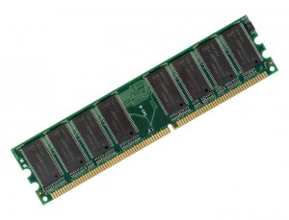
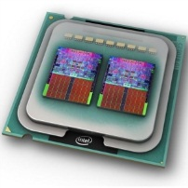
The Cell Probe Model
Powerful Model:
  Allow arbitrary instructions, depending on everything probed.
Natural Question: Is it too powerful?
  In many cases: No, have matching word-RAM upper bounds.
Example of problem where have very efficient cell probe data structure, but no efficient word-RAM solution?
  Have one concrete example.
Notes:
Overlay poly, telefon

Slide 40
Fine-Grained Complexity
Central Hardness Conjecture:
  Online Matrix-Vector Multiplication (OMV).
Receive boolean nxn matrix M.
Then receive n query vectors v₁,…,v_{n} in {0,1}^{n}, one at a time.
Goal: Output Mv_{i} before seeing v_{i+1}.
Matrix-vector product over Boolean semi-ring: + is OR and * is AND.
1 | 1 | 1 | 0 | 1
1 | 0 | 0 | 1 | 1
0 | 0 | 0 | 1 | 0
1 | 1 | 1 | 0 | 1
0 | 0 | 1 | 1 | 0
1
0
0
1
0
0
1
0
1
1
1
1
0
0
0
1
0
0
0
0
1
1
0
1
0
Notes:
Overlay poly, telefon

Slide 41
Fine-Grained Complexity
Central Hardness Conjecture:
  Online Matrix-Vector Multiplication (OMV).
Conjecture: Total time at least n^{3-o(1)}, Henzinger et al.’15.
Via reductions: Tight conditional lower bounds for many dynamic data structure problems, including e.g. directed connectivity.
1 | 1 | 1 | 0 | 1
1 | 0 | 0 | 1 | 1
0 | 0 | 0 | 1 | 0
1 | 1 | 1 | 0 | 1
0 | 0 | 1 | 1 | 0
1
0
0
1
0
0
1
0
1
1
1
1
0
0
0
1
0
0
0
0
1
1
0
1
0
Notes:
Overlay poly, telefon

Slide 42
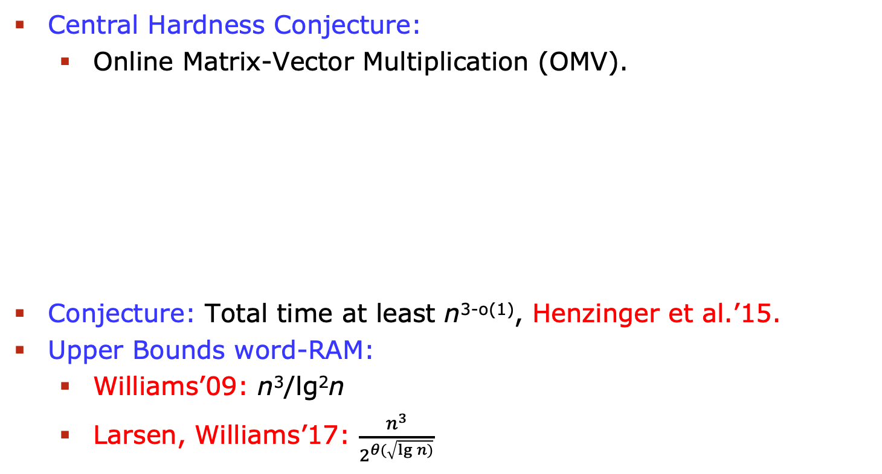
The Cell Probe Model
Central Hardness Conjecture:
  Online Matrix-Vector Multiplication (OMV).
Conjecture: Total time at least n^{3-o(1)}, Henzinger et al.’15.
Upper Bounds word-RAM:
  Williams’09: n³/lg²n
  Larsen, Williams’17: $\frac{n^{3}}{2^{θ(\sqrt{\lg{n})}}}$
1 | 1 | 1 | 0 | 1
1 | 0 | 0 | 1 | 1
0 | 0 | 0 | 1 | 0
1 | 1 | 1 | 0 | 1
0 | 0 | 1 | 1 | 0
1
0
0
1
0
0
1
0
1
1
1
1
0
0
0
1
0
0
0
0
1
1
0
1
0
Upper Bounds cell probe:
  Larsen, Williams’17: n^{2.75}
  Chakraborty, Kamma, Larsen’18: n^{2.5}
Notes:
Overlay poly, telefon

Slide 43
Succinct Data Structures
Succinct (static data structures):
  Space is very close to information theoretic minimum.
Formally: If n bits is information theoretic minimum space, then use n+r bits of space, where r is redundancy.
  Tons of upper bounds!
  Succinct rank/select, range minimum etc.
1 | 1 | 1 | 0 | 1
Notes:
Overlay poly, telefon

Slide 44
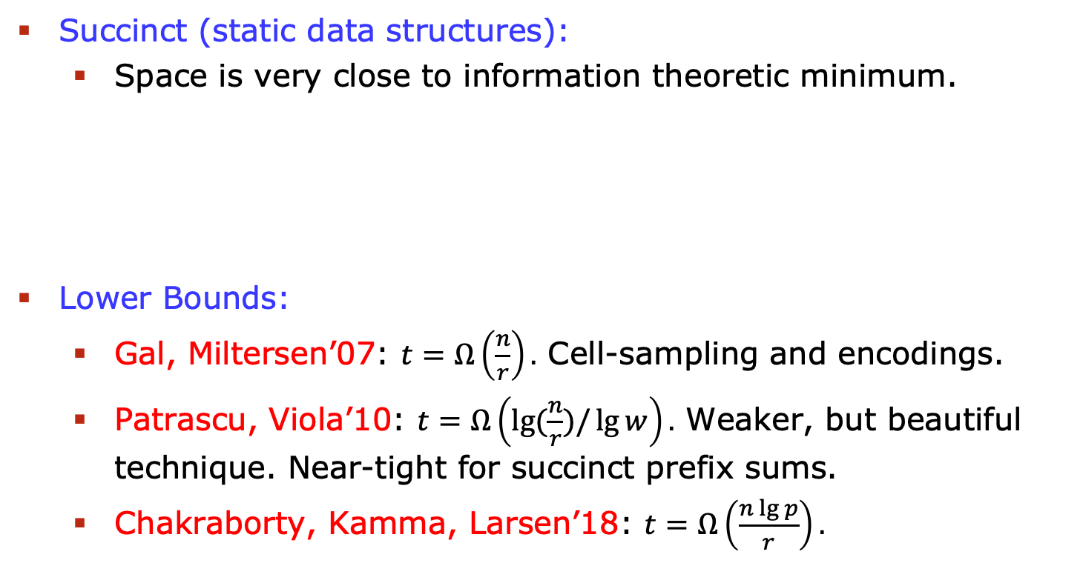
Succinct Data Structures
Succinct (static data structures):
  Space is very close to information theoretic minimum.
Lower Bounds:
  Gal, Miltersen’07: $t=Ω\left(\frac{n}{r}\right).$ Cell-sampling and encodings.
  Patrascu, Viola’10: $t=Ω\left(\lg{(\frac{n}{r})/\lg{w}}\right).$ Weaker, but beautiful technique. Near-tight for succinct prefix sums.
  Chakraborty, Kamma, Larsen’18: $t=Ω\left(\frac{n\lg{p}}{r}\right).$
1 | 1 | 1 | 0 | 1
Notes:
Overlay poly, telefon

Slide 45
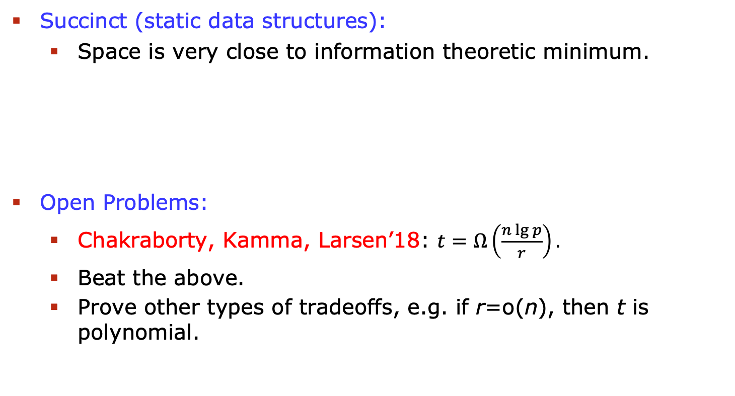
Succinct Data Structures
Succinct (static data structures):
  Space is very close to information theoretic minimum.
Open Problems:
  Chakraborty, Kamma, Larsen’18: $t=Ω\left(\frac{n\lg{p}}{r}\right).$
  Beat the above.
  Prove other types of tradeoffs, e.g. if r=o(n), then t is polynomial.
1 | 1 | 1 | 0 | 1
Notes:
Overlay poly, telefon

Slide 46
Crypto
Very recent direction:
  Lower bounds in crypto via cell probe techniques.
Larsen, Nielsen’18 CRYPTO Best Paper.
Oblivious RAM:
  Introduced by Goldreich and Ostrovsky’96
  “Encrypts” memory access pattern of algorithm.
Notes:
Overlay poly, telefon

Slide 47
Oblivious RAM, Model
Server
  A large, passive store of data, a random-access memory
Client
  Runs a program which simulates a large memory (an array with random access)
  Has a small persistent memory
  Outsources the rest of the data to the server
Eavesdropper
  Sees access pattern to the server
  Does not see the actual data
Security
  For any two sequences of access to the array of the same length, the access pattern seen by Eavesdropper are indistinguishable

Slide 48
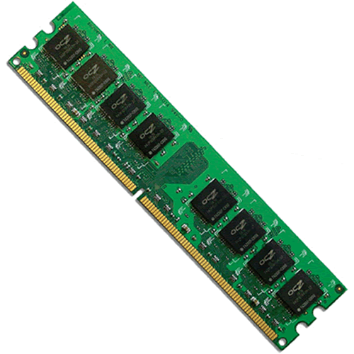

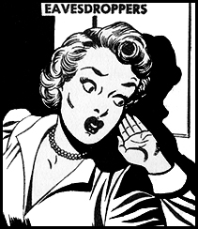
r

Slide 49
Bandwidth Overhead
The most important performance metric is the bandwidth overhead.
If after N accesses the ORAM makes M probes, then
Overhead = M / N

Slide 50
Upper Bounds
Goldreich, Ostrovsky, 1996: poly(log(N))
A lot of research on more efficient ORAMs
optORAMa, 2018 [Asharov, Komargodski, Lin, Nayak, Shi]
  Overhead log(N)

Slide 51
Oblivious RAM, Model
r
Probes
Memory
Array
Client memory

Slide 52
Proof
Simple case:
  No client memory
  Perfect obliviousness

Slide 53
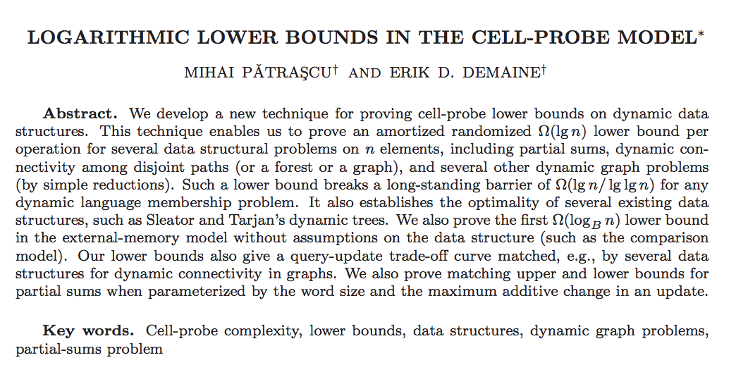
8
How many times must the read-sequence probe a cell which was last time probed during the write-sequence?
w(1,r₁)
w(2,r₂)
w(3,r₃)
w(4,r₄)
w(5,r₅)
w(6,r₆)
w(7,r₇)
w(8,r₈)
r(1)
r(2)
r(3)
r(4)
r(5)
r(6)
r(7)
r(8)

Slide 54
?
How many times must the last half probe a cell which was last time probed during the first half?
r(0)
r(0)
r(0)
r(0)
r(0)
r(0)
r(0)
r(0)
r(0)
r(0)
r(0)
r(0)
r(0)
r(0)
r(0)
r(0)

Slide 55
r
Probes
Memory
Array
8?

Slide 56
8
How many times must the last half probe a cell which was last time probed during the first half?
r(0)
r(0)
r(0)
r(0)
r(0)
r(0)
r(0)
r(0)
r(0)
r(0)
r(0)
r(0)
r(0)
r(0)
r(0)
r(0)

Slide 57
4
4
How many times must the first read-sequence probe a cell which was last time probed during the first write-sequence?
How many times must the second read-sequence probe a cell which was last time probed during the second write-sequence?
w(1,r₁)
w(2,r₂)
w(3,r₃)
w(4,r₄)
r(1)
r(2)
r(3)
r(4)
w(5,r₅)
w(6,r₆)
w(7,r₇)
w(8,r₈)
r(5)
r(6)
r(7)
r(8)

Slide 58
8
4
4
The probes counted in different circles are distinct!
r(0)
r(0)
r(0)
r(0)
r(0)
r(0)
r(0)
r(0)
r(0)
r(0)
r(0)
r(0)
r(0)
r(0)
r(0)
r(0)

Slide 59
2
2
2
2
How many times must the first read-sequence probe a cell which was last time probed during the first write-sequence?
w(1,r₁)
w(2,r₂)
r(1)
r(2)
w(3,r₃)
w(4,r₄)
r(3)
r(4)
w(5,r₅)
w(6,r₆)
r(5)
r(6)
w(7,r₇)
w(8,r₈)
r(7)
r(8)

Slide 60
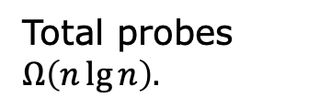
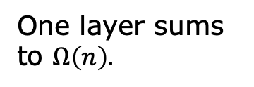
8
4
One layer sums to $Ω\left(n\right).$
4
2
2
2
2
1
1
1
1
1
1
1
1
lgn layers.
Total probes $Ω\left(n\lg{n}\right).$
r(0)
r(0)
r(0)
r(0)
r(0)
r(0)
r(0)
r(0)
r(0)
r(0)
r(0)
r(0)
r(0)
r(0)
r(0)
r(0)

Slide 61
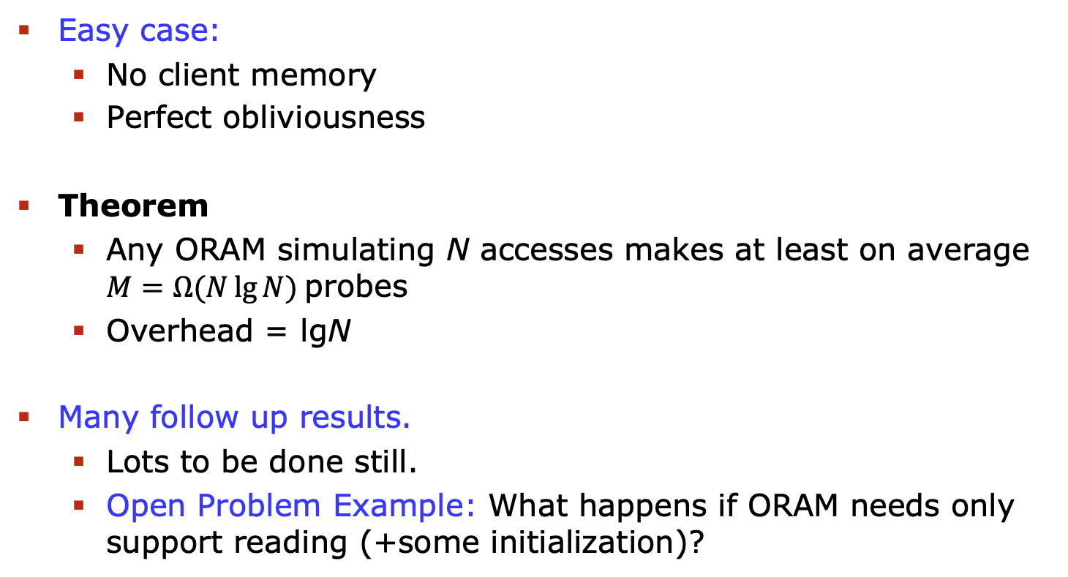
Theorem
Easy case:
  No client memory
  Perfect obliviousness
Theorem
  Any ORAM simulating N accesses makes at least on average $M=Ω(N\lg{N)}$probes
  Overhead = lgN
Many follow up results.
  Lots to be done still.
  Open Problem Example: What happens if ORAM needs only support reading (+some initialization)?

Slide 62
Lots of Concrete Lower Bounds
Nearest Neighbor Search
Predecessor Search
Union-Find
Prefix Sums
Range Searching
Range Selection/Median
Range Mode
Undirected Dynamic Connectivity
Directed Connectivity
Succinct Data Structures
Non-Adaptive Streaming Algorithms
Notes:
Overlay poly, telefon

Slide 63
Summary
Lots of beautiful theory to be made.
Techniques have applications outside data structures.
Encoding arguments very useful outside data structures too.
Hope you’ll join!
Notes:
Overlay poly, telefon

